Slide 1
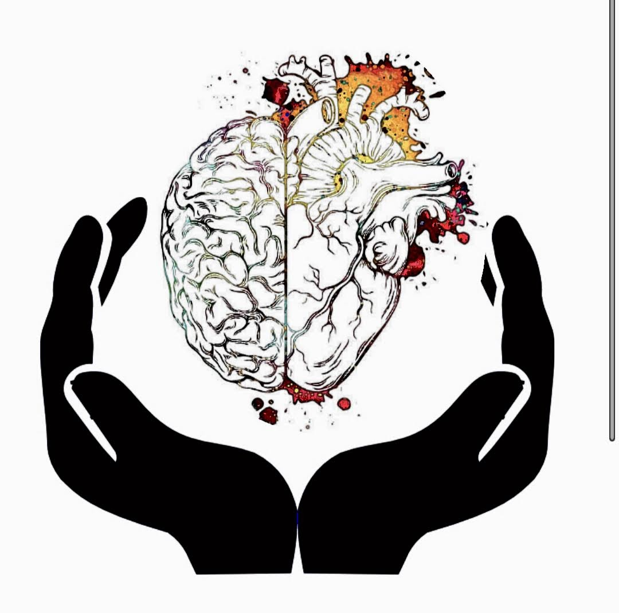
Pediatric Neurodevelopment
Deanna McCulloch, PhD, LCPC

Slide 2
Outline
Basic Neuroscience & Mental Health
Epigenetics
In Utero Development
Typical Development
Impacts to Development
Take Aways

Slide 4
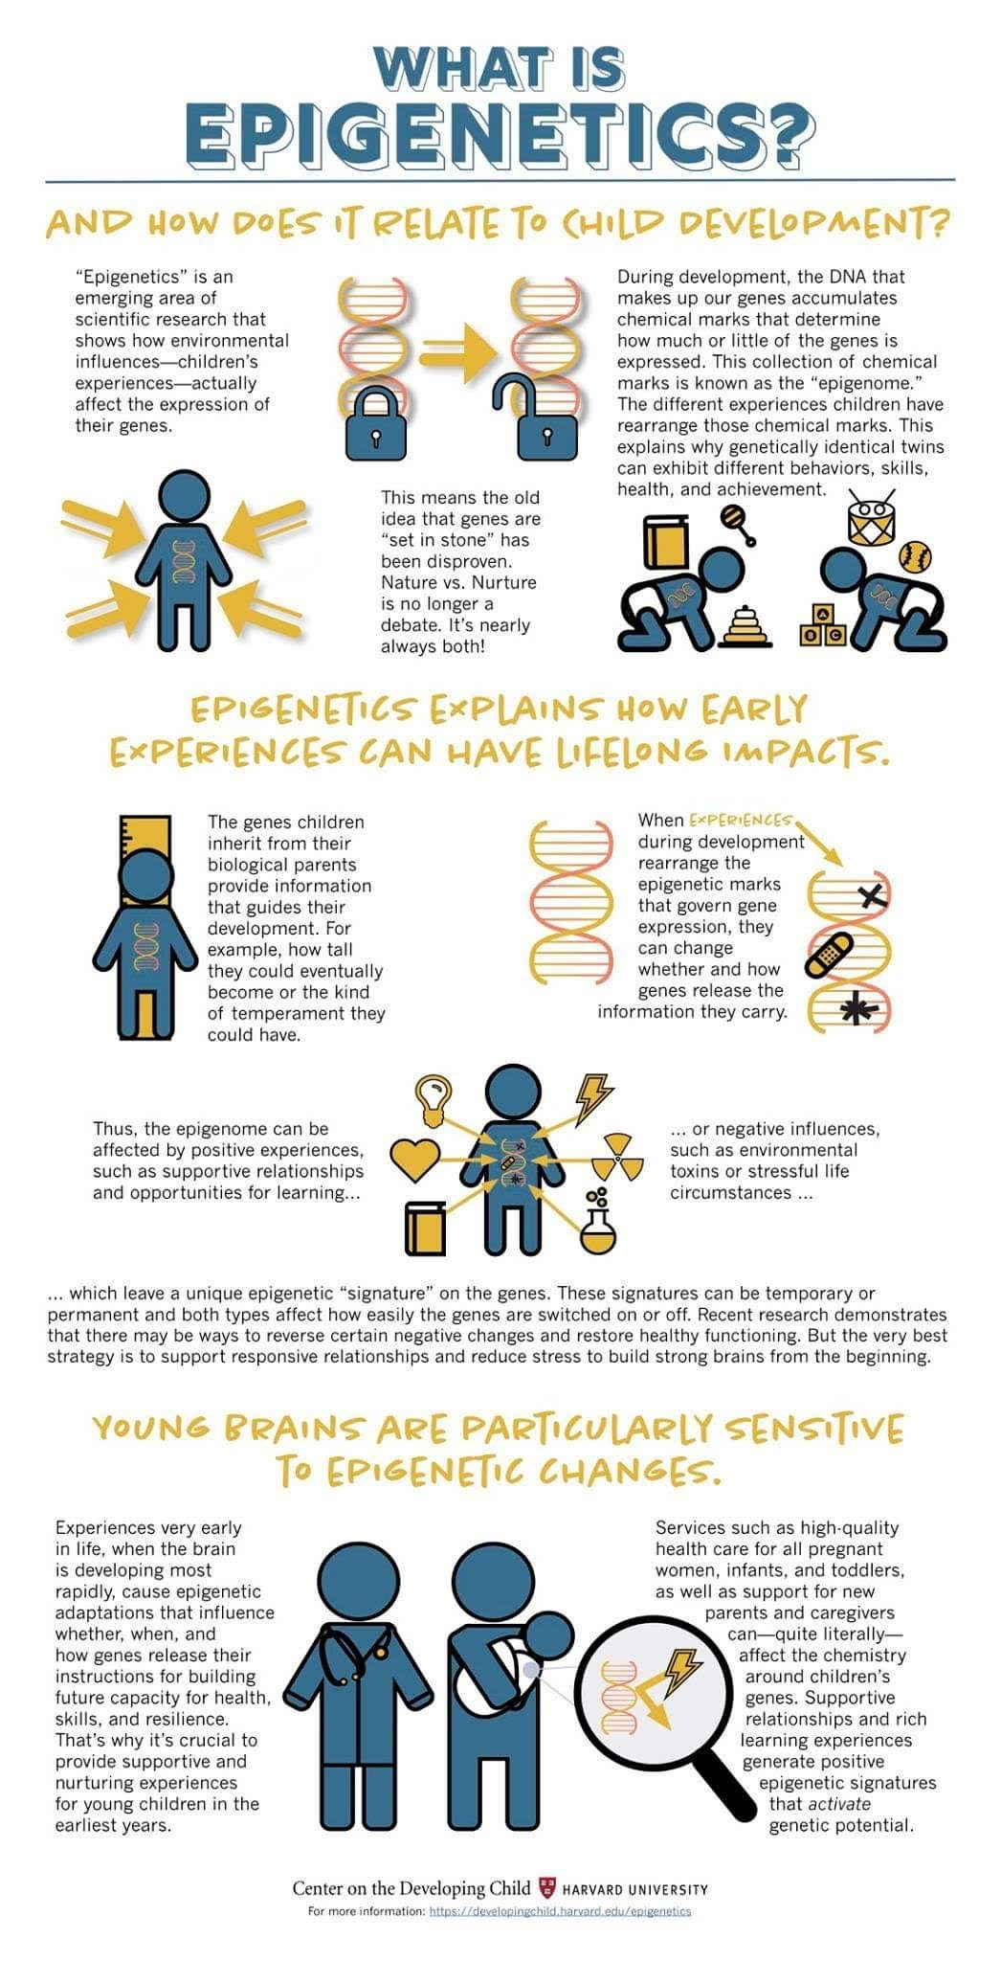
Epigenetics
Limbic Template
Are limbic template is the map of our brain
Epigenetics
In Utero Experiences
Life Experiences
Grooves are the neurological pathways that make up and individual's static stress level…. Neural Connections
Frequency
Intensity
Grooves have the ability to change, our brains have a huge level of plasticity

Slide 5
Typical Development

Slide 7
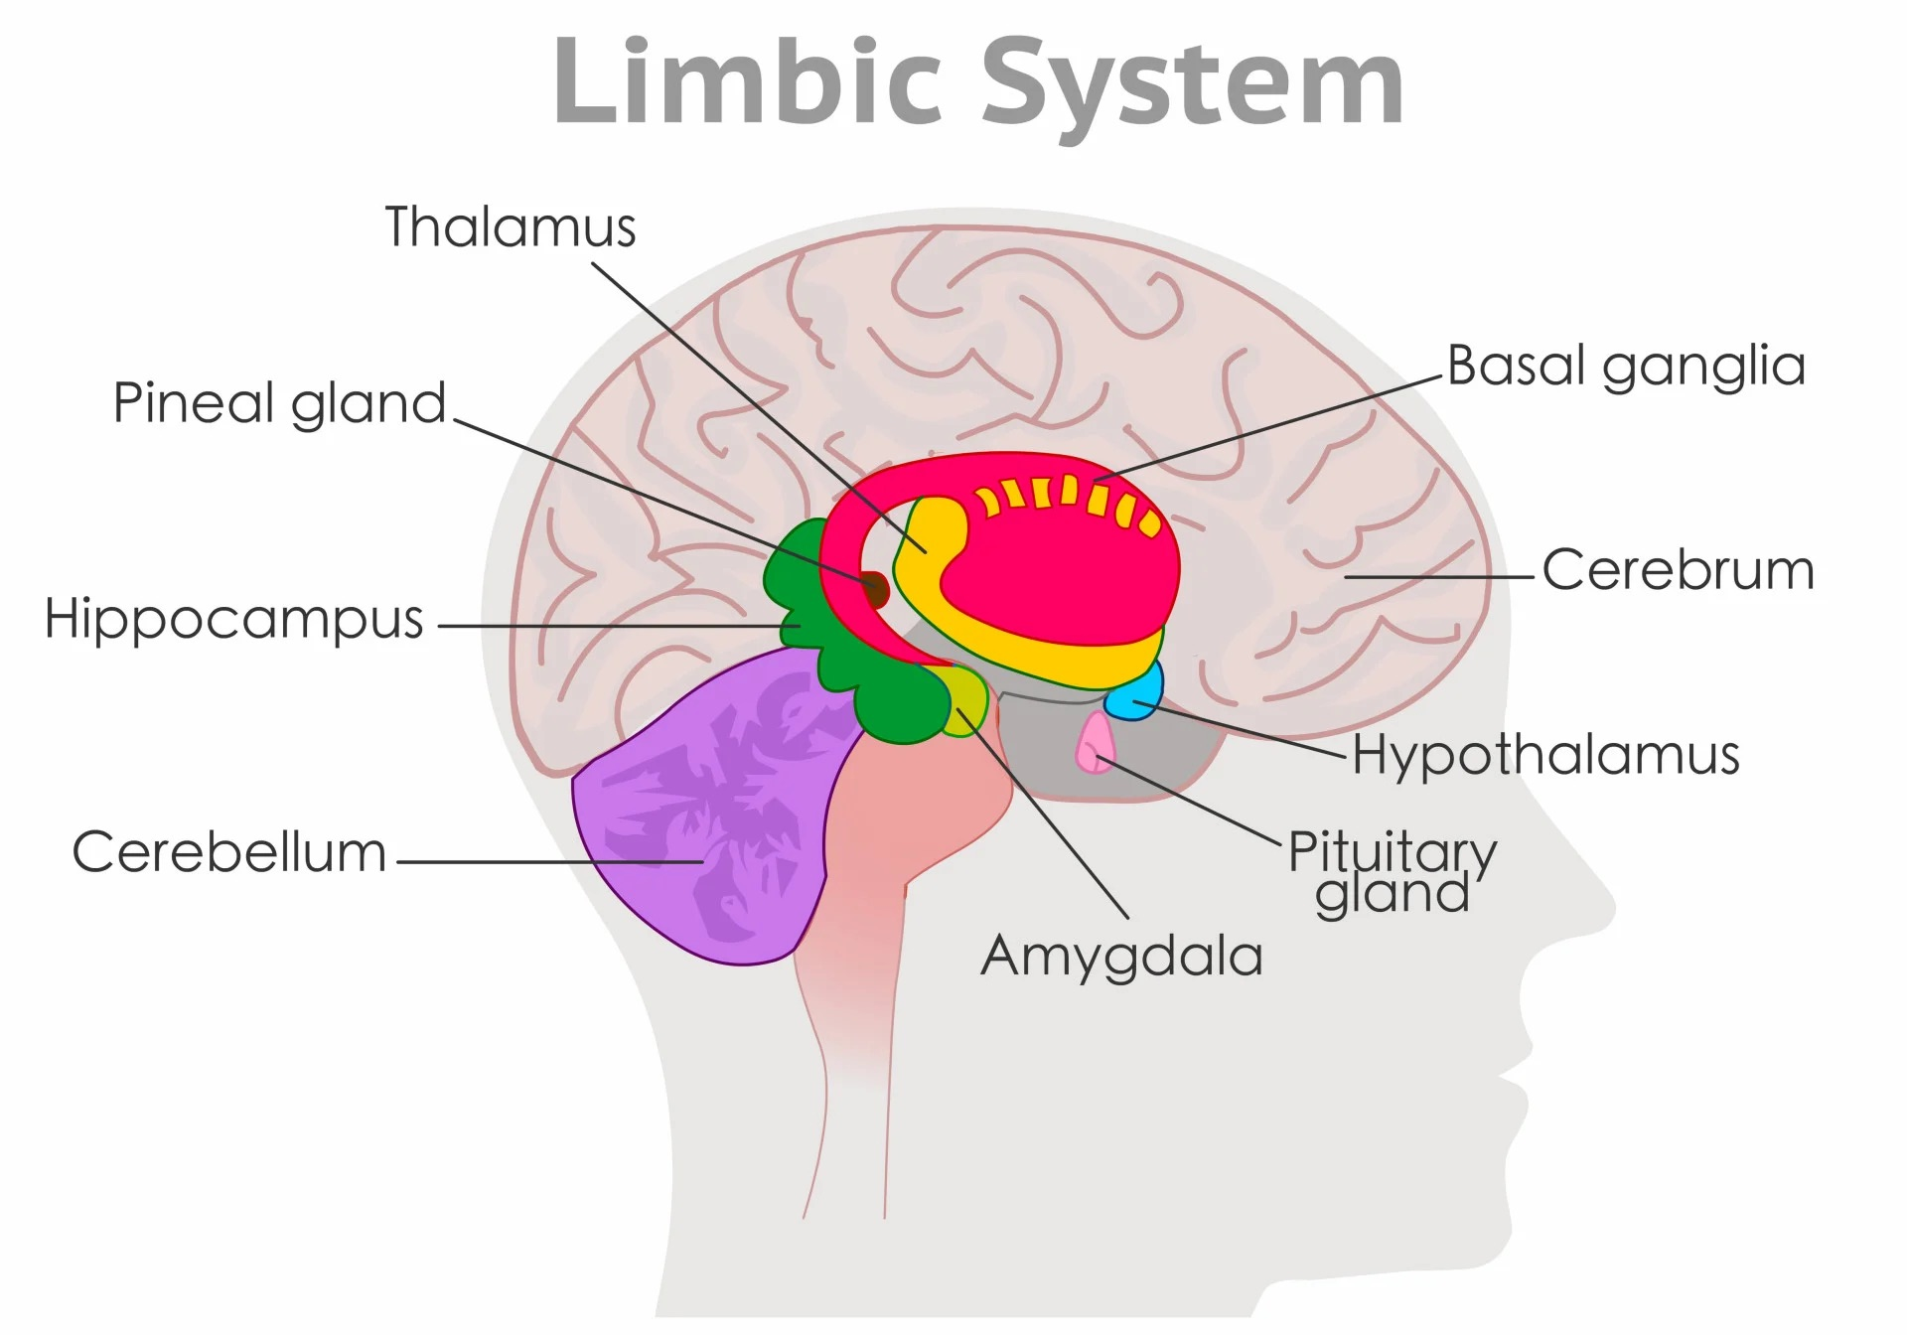

Slide 9
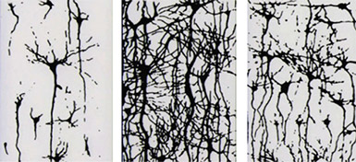
Pruning

Slide 10
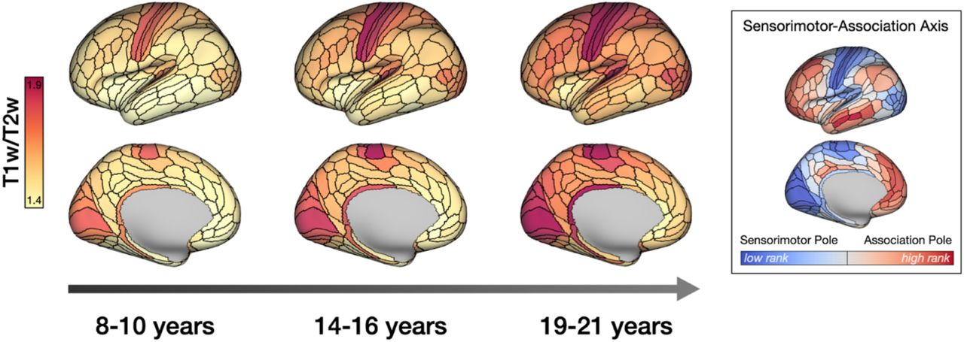
Neocortical Development

Slide 11
Why is this distinction so important?

Slide 12
Neurodivergencies
Trauma
Neurodevelopmental Disorders

Slide 13
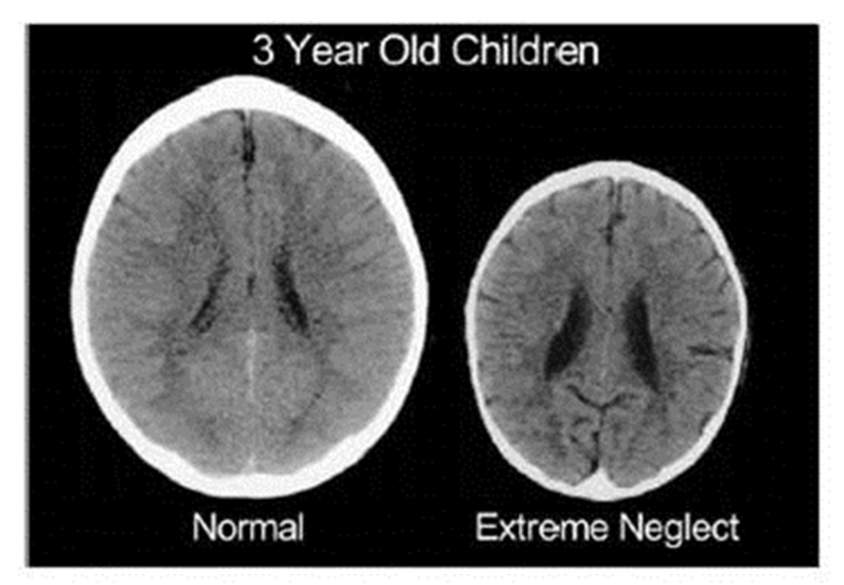
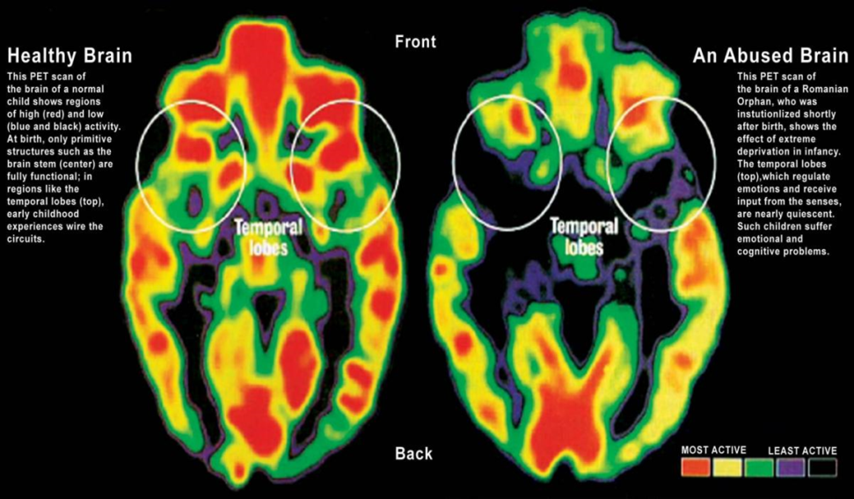
Trauma and the Brain
Structure
Connectivity

Slide 15
AUTISM, ADHD & VAST
TRAUMA
REJECTION SENSITIVITY
INPUT/OUTPUT
Cerebellum- Oscillation dampener
10% of volume
75% of neural connections
Balance movement and vision
Task Positive Network TPN
Default Mode Network DMN

Slide 16
Populations of Concern
Poverty
Underserved Minority Populations
Transgenerational Trauma
LGBTQ+ Youth
Children of Veterans
Learning Differences

Slide 17
REGULATION

Slide 18
Continuum of Adaptive Responses to Threat
Internal State | Calm | Arousal | Alarm | Fear | Terror
Brain Sate | NeoCortex | Cortex Limbic | Limbic Midbrain | Midbrain Brainstem | Brainstem Autonomic
Dysregulation Continuum | Rest | Vigilance | Resistance (Crying) | Defiance (Tantrums) | Aggression (Outbursts)
Dissociative Continuum | Rest | Avoidance | Compliance (Robotic) | Disassociation (Rocking) | Fainting
Cognitive Style | Abstract | Concrete | Emotional | Reactive | Reflexive
Adapted from Perry, 2001
Notes:
In the fearful child a defiant stance is often seen. This is typically interpreted as a willful and controlling child. Adults often respond to the oppositional behavior by becoming angry or more demading. The child overreadin the non-verbal cues of the frustrated adult feels more threatened and moves from alarm to fear and fear to terror the behavior of the child reflects their attempts to adapt and respond to a percieved or mispercieved threat

Slide 19
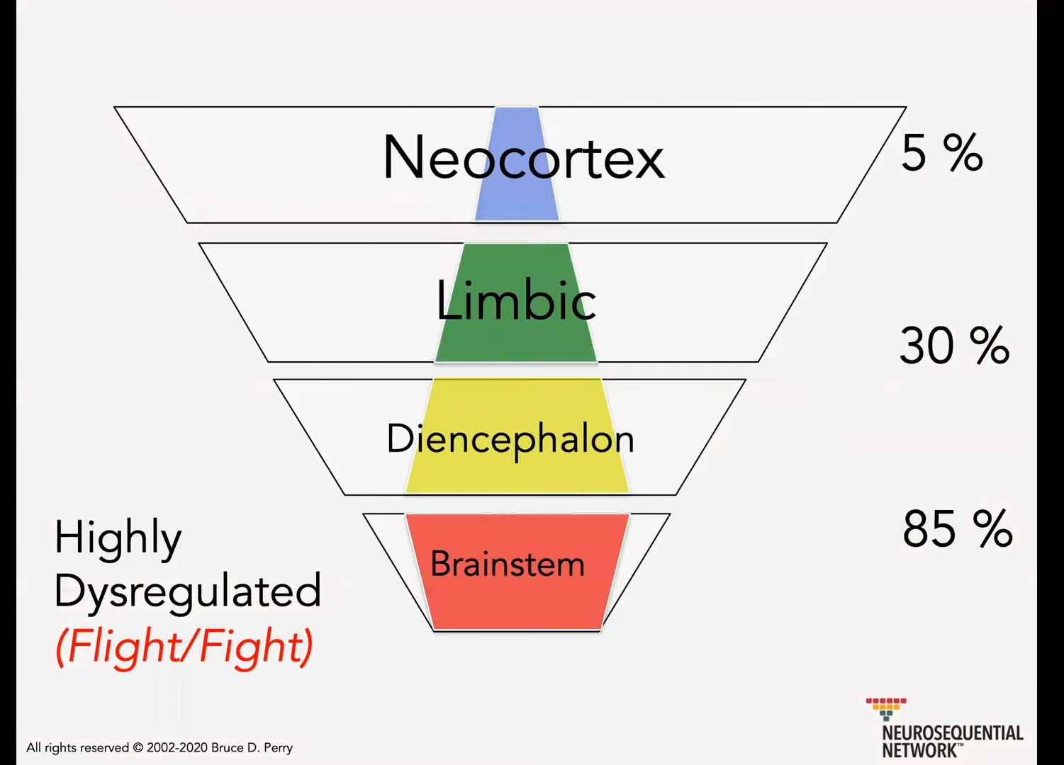

Slide 20
WHAT DO WE DO?

Slide 21
BOTTOM UP AND ALL AROUND
BASIC NEEDS
FELT SAFETY
PARENTING SUPPORT
INTERDEPENDANCE
SUPPORT
ACCOMODATIONS
NEUROBIOLOGICALLY INFORMED INTERVENTIONS

Slide 22
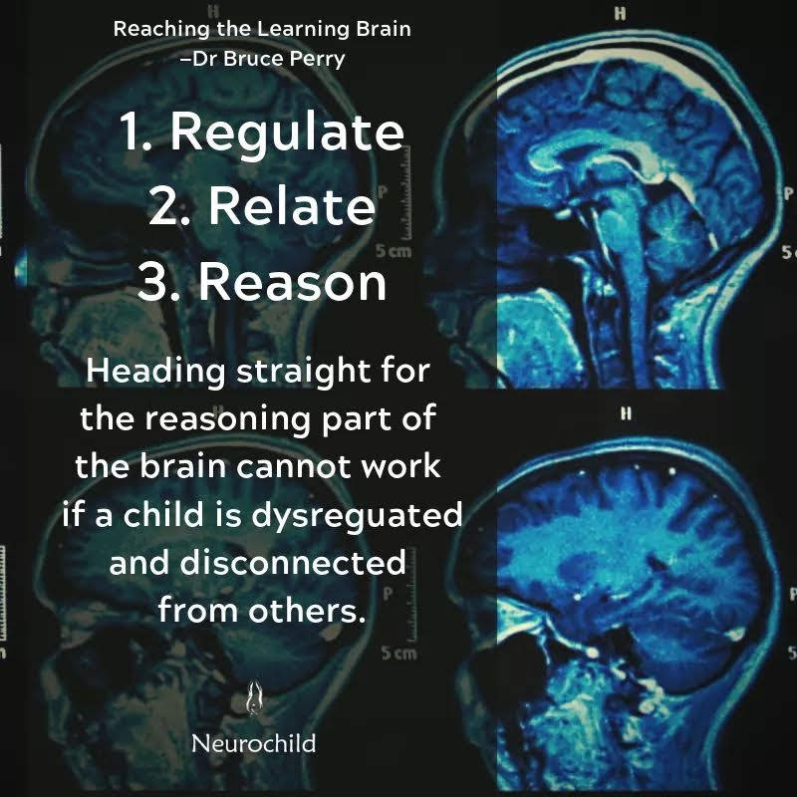
Regulation before all else

Slide 23
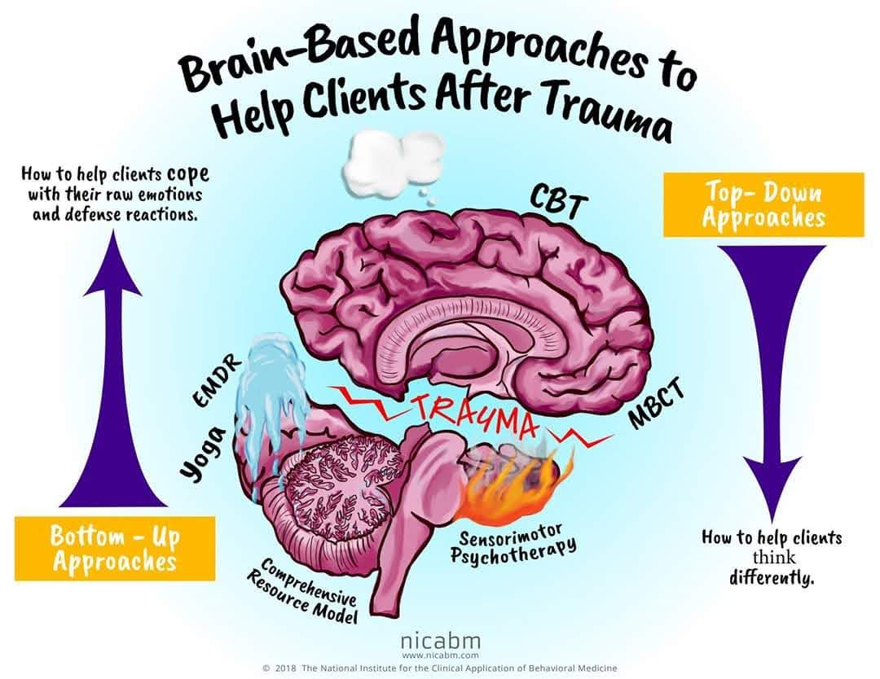

Slide 24
NEUROBIOLGOICALLY INFORMED INTERVENTIONS
WHAT WE DO
HOW WE DO IT
Integrated Health
Multidisciplinary Communication
The words you use matter
Shifting the Paradigm
Advocating for the needs to be addressed vs behaviors
Regulation before words
What words are you using
Tone
Appropriate to their current cognitive functioning
Alternative forms of communication

Slide 25
Neurobiologically Informed Models
Top Down
Combination
Bottom Up
CBT
ABA
SFT
TFCBT
NCBT
DBT
Talk Therapy
EMDR
SMART
NMT
Play Therapies

Slide 26
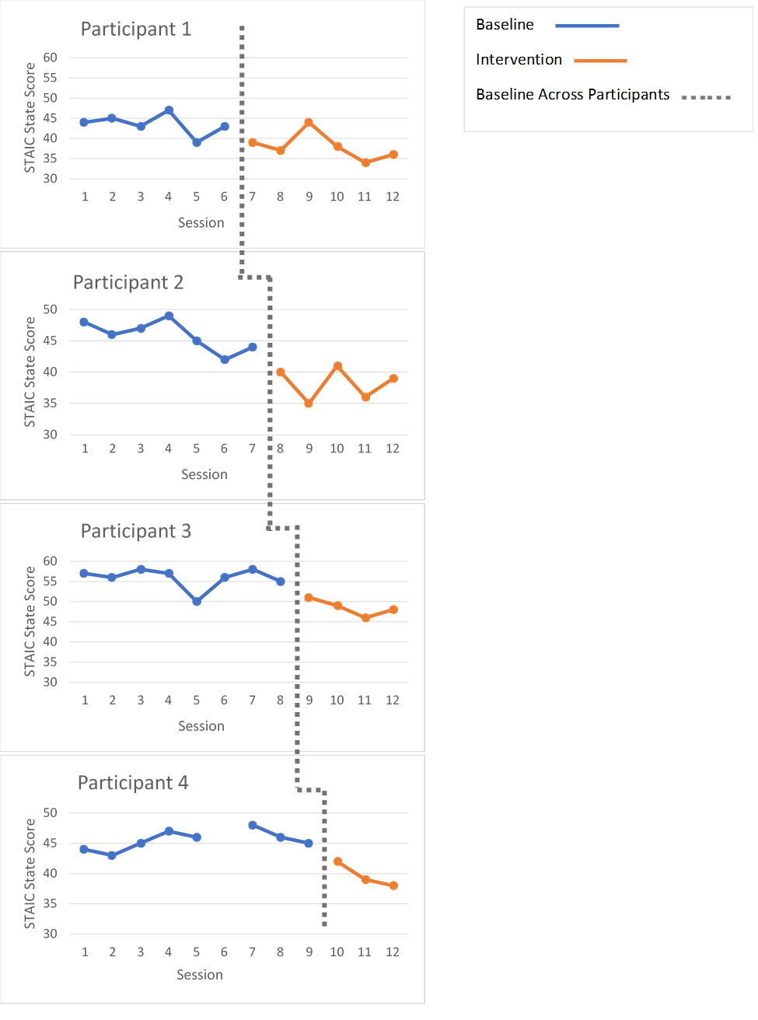
Effects of Sensory Bin Use
Hear Rate
STAIC Score

Slide 27
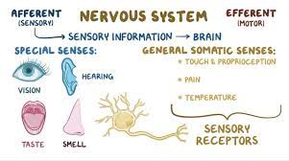
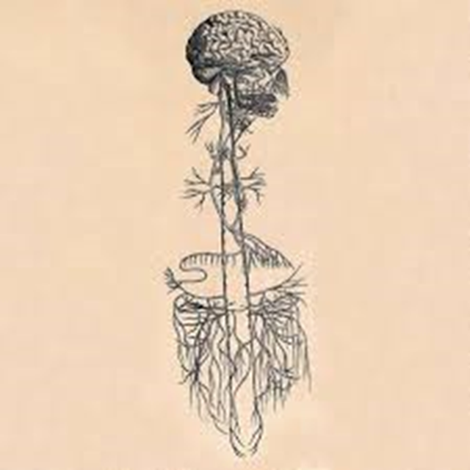
Somatosensory System

Slide 28
Core Paradigm Shifts
Create Safety
Acceptance
Needs not Behaviors
Whole Human
Interdependence vs Independence

Slide 29
Questions?
Thank you
Deanna McCulloch, PhD, LCPC
Owner and Clinical Director
Connected Counseling
406-201-1485
DeannaMcCulloch@connectedcounseling.space
ConnectedCounseling.space

