Slide 1
Covid and Grief
MARY-ANN SONTAG BOWMAN PH.D. LCSW
UNIVERSITY OF MONTANA

Slide 2
Pandemic Life
“I was berating myself for not getting enough completed each day and week, wondering why I couldn’t get that last towel bar hung up. Those few papers filed. I told myself I was being lazy, that I wasn’t trying hard enough, that I wasn’t focusing.”

Slide 3
Change = Loss

Slide 4
Pandemic Life: WHAT have WE lost?
Time
Sense of Ease/Safety
Bereavement Rituals
Our elders
Mental health
Income/Job
Hope
Motivation
Holidays
`
Relationships
Non-verbal communication
Routine
Social Life
Childhood
Patience
Compassion
Opportunities
Presence

Slide 5
Pandemic Life: WHAT have WE lost?
Human Connection

Slide 6
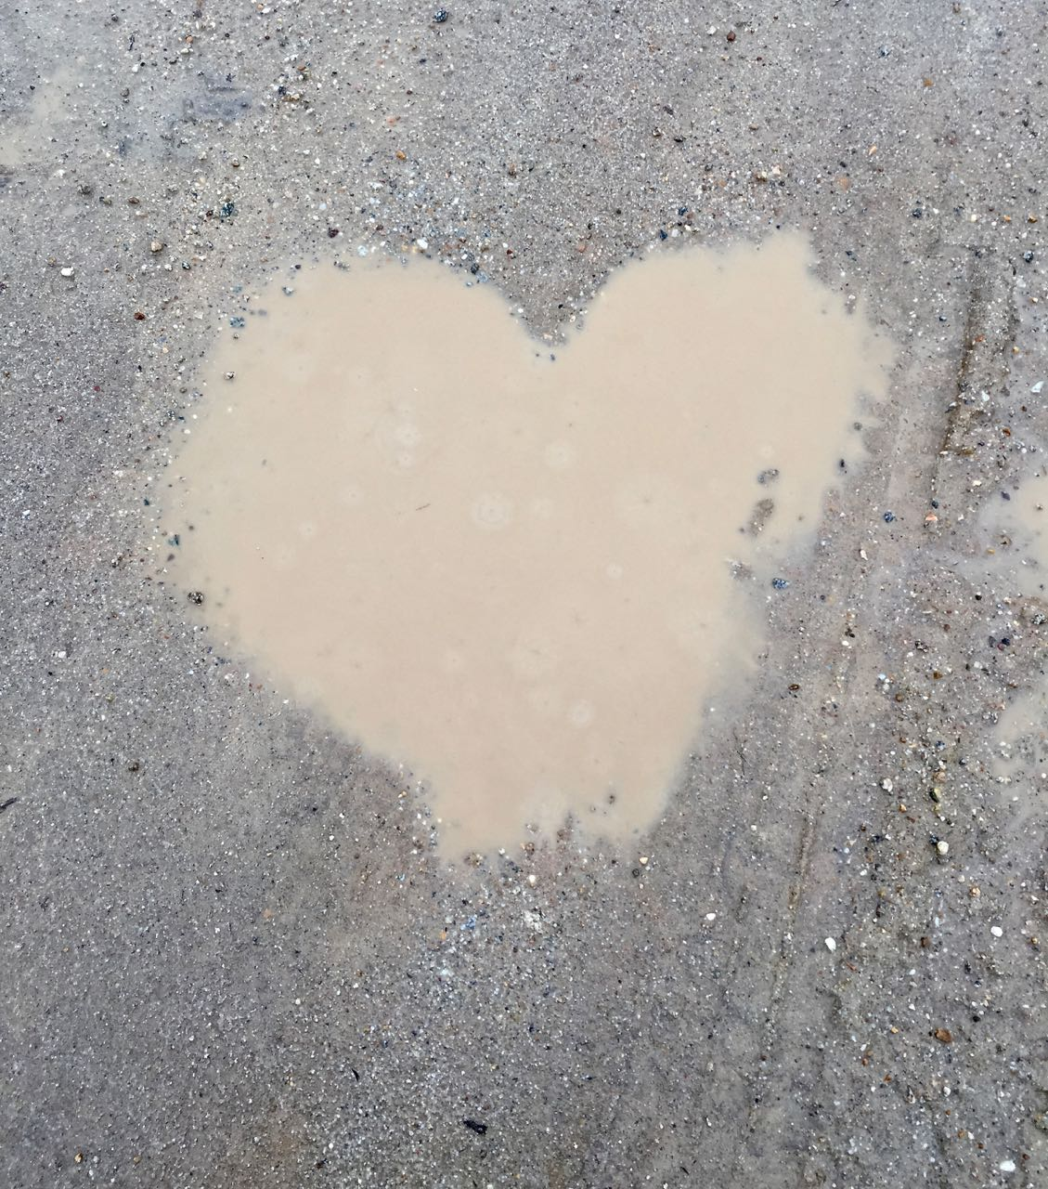
Pandemic Losses
Disenfranchised

Slide 7
Pandemic Losses
Cumulative

Slide 8
Change = Loss = Grief

Slide 9
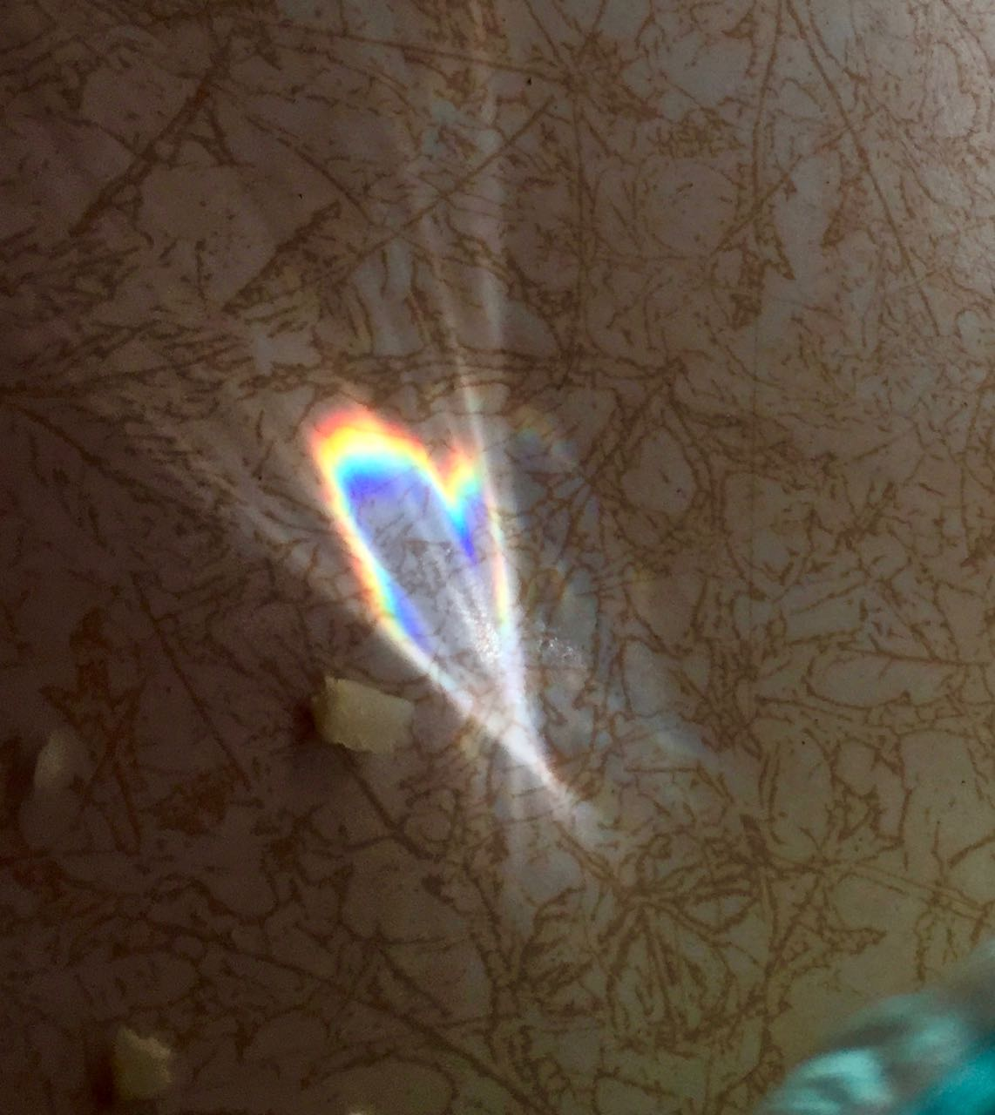
Grief…
…is universal and profoundly personal.
…is not a problem to be solved.
…doesn’t involve stages.
…doesn’t have a time limit or an end.
…is 100% normal.

Slide 10
Experiences & Expressions of Grief
Emotional
Social
Cognitive
Spiritual
Physical
Rubin Image

Slide 11
What is griefworthy? What is not? Who decides?

Slide 12
Pandemic Losses
Loss of Human Connection
means
Socially Distant Support

Slide 13
Coping Resources are Finite
Image from members.upnaway.com

Slide 14
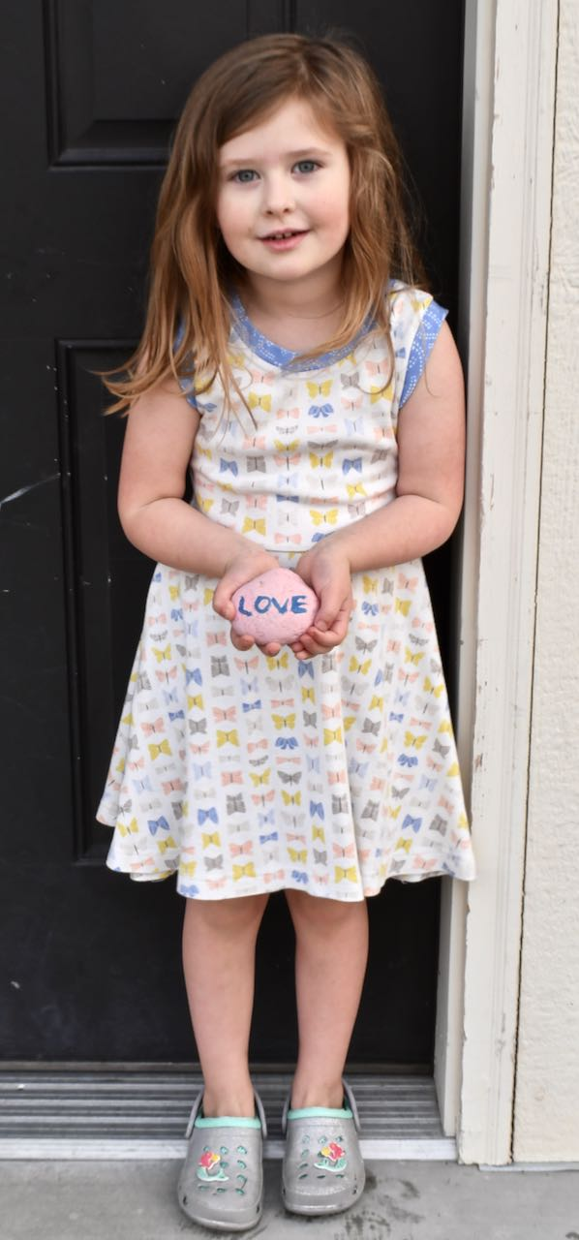
How to Cope
Recognize loss burden
Understand normal grief
Self-awareness
Suspend judgment
Avoid “at least…”
Acknowledge coping resources are finite
Dial back
Layer additional resources – not demands
So much Grace

Slide 15
How to Help
Recognize loss burden
Understand normal grief
Listen
Suspend judgment
Educate and normalize
Avoid platitudes
Acknowledge coping resources are finite
Encourage and support dialing back
Layer additional resources – not demands
So much Grace

Slide 16
“In the middle of difficulty lies opportunity”
Albert Einstein

Slide 17
www.helpwithgrief.org
MARY-ANN SONTAG BOWMAN PH.D. LCSW
UNIVERSITY OF MONTANA
mary-ann.bowman@umontana.edu

